Slide 1
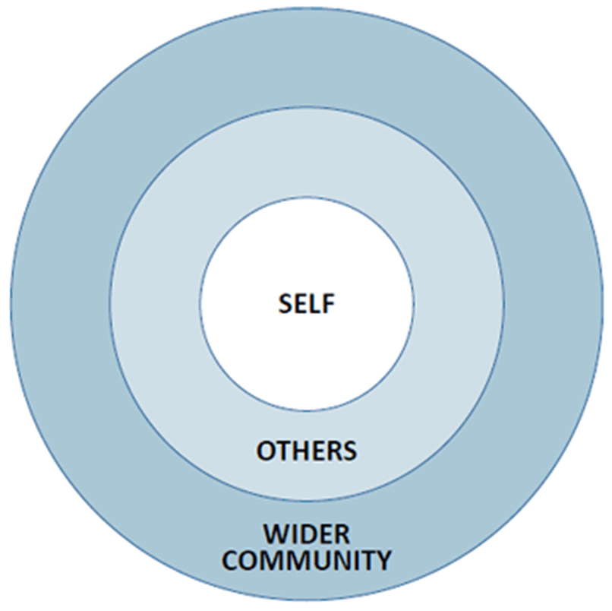
Incorporating Maternal and Child Health Leadership Competencies and Objectives into a LEND Trainee Curriculum
Mayra Alvarez, PhD, Elisa Muñiz, MD, MS, & Kathleen McGrath, MSS, LSW
RFK Children’s Evaluation and Rehabilitation Center, Montefiore Medical Center, Albert Einstein College of Medicine
OBJECTIVES
METHODOLOGY
RESULTS
To evaluate the efficacy of the LEND Trainee Curriculum in teaching MCH leadership competencies
To identify areas of needed improvement through a pre and post self-assessment
LEND trainees (n=14) at the Rose F. Kennedy Children’s Evaluation and Rehabilitation Center, a multidisciplinary tertiary care facility at Albert Einstein College of Medicine/Montefiore Medical Center, completed a 9 month training curriculum developed using MCH Leadership Competencies as its foundation.
As part of their LEND training curriculum, trainees participated in weekly didactic lectures that each addressed a core MCH competency and completed final presentations. Lectures featured guest speakers and interactive dialogue centered on each core competency (e.g., ethics, engaging with communities, policy and advocacy, etc.).
Trainees completed a pre- and post- curriculum self-assessment tool provided by the AUCD Network. The self-assessment features a battery of Likert-scale items that address each MCH competency.
Main Findings
Paired t-tests revealed statistically significant (p<.05) improvement in mean scores across all competencies.
The greatest increase in scores was seen in the following categories:
critical thinking (basic)
communication (advanced)
negotiation and conflict resolution (basic)
individual/family-centered services and supports (basic/advanced),
policy and advocacy (basic)
The smallest increase in scores was seen in the following categories:
self-reflection(basic)
communication (basic)
negotiation and conflict resolution (advanced)
teaching and mentoring (basic)
BACKGROUND
Leadership Education in Neurodevelopmental and Related Disabilities (LEND) programs provide interdisciplinary training in developmental disabilities. The purpose of the LEND training program is to create future leaders in the areas of training and service and therefore benefit the health of infants, children, and adolescents with disabilities. Trainees are instructed through didactic and experiential methods to improve skills in diagnostics, health care delivery, integration of services, community partnerships, cultural competency and interdisciplinary training and advocacy.
At the RFK Children’s Evaluation and Rehabilitation Center, the LEND trainee curriculum is delivered primarily through weekly didactic lectures and is driven by the Maternal and Child Health (MCH) Leadership Competencies. The MCH Leadership Competencies offer a framework for leadership training across the following domains:
Self (MCH knowledge base/context, self-reflection, ethics, critical thinking),
2. Others (communication, negotiation and conflict resolution, cultural competency, family-professional partnerships, developing others through teaching, coaching, and mentoring, interdisciplinary team building) and
3. The Wider Community (working with communities and systems, policy).
Basic & Advanced Competencies combined
CONCLUSIONS
Findings suggest that LEND trainees improved across all competencies after completing the 9 month training program. Future studies would be beneficial to examine which aspects of the curriculum most impact this improvement.
malvare1@montefiore.org

